Slide 1
The Value of Being a
certified records manager
Michael DeVanna, MLS, CRM
Enterprise Records Manager
Florida Blue
September 20, 2018

Slide 2
The Value of Being a
certified records manager (CRM)
Industry surveys show a value proposition for records and information management (RIM) professionals who achieve the CRM designation.
  Supply and demand. There are, at present, thirty-seven active CRMs in Florida.
A Candidate’s belief that certification will provide for enhanced professionalism and personal growth is a significant factor in the overall decision to become a CRM.
  Professional and personal self-improvement. Striving toward these goals is natural.
RIM knowledge gained through the certification process, and elevation of confidence as a result of mastering RIM competencies, is directly related to the CRM’s ability to garner higher-level RIM positions with commensurate salaries.
  Supply and demand. Increase your value to employers and prospective employers.

Slide 3
The Value of Being a
certified records manager
CRM certification shows a commitment to continued professional learning.
    Maintaining active status as a CRM requires ongoing study and documentation of same.
CRM certification is recognized as the records management gold standard.
    Employers and headhunters ask for a CRM more than any other RIM-related certification.
CRM certification can help your résumé move to the top of the applicant list.
    Supply and demand. How many CRMs are actually looking for work?

Slide 4
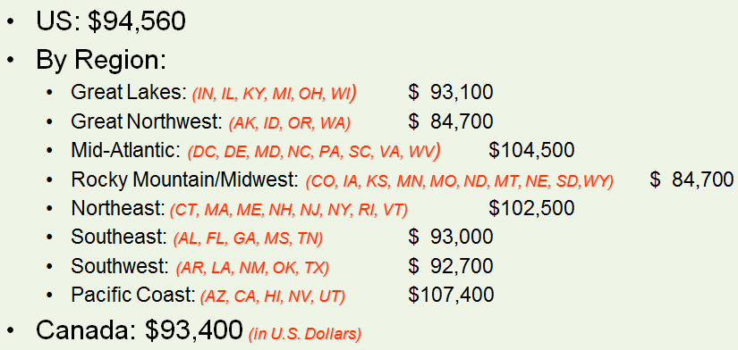
2007 Average Salaries for CRMs*
*2018 salary survey results are scheduled to be released on October 21st.

Slide 5
How to Become a Certified Records Manager (CRM) or a Certified Records Analyst (CRA)
Apply online to qualify to sit for the exams.
Applications are reviewed and approved by the ICRM Certification Standards Committee.
As a Candidate you are eligible to sit for the exams.
Six CRM exams must be completed within five years.
Three CRA exams may be taken during the same week.

Slide 6
Applying for the CRM or CRA Exams
Prospective Candidates must complete and submit an online application, with supporting documentation, indicating acceptable education and professional work.
Once the application has been submitted the prospective Candidate becomes an Applicant.
The application and supporting documentation will be reviewed and evaluated by the ICRM to determine if the qualification requirements have been met.

Slide 7
Preferred Qualifications for CRM and CRA
Bachelor’s degree
One year of professional RIM experience
One year of RIM experience may substitute for one year of education
  e.g., three years of college plus two years of RIM experience

Slide 8
Professional RIM Experience Means…
Conducted RIM-related studies or surveys
Designed, developed, or implemented records management systems
Managed or supervised RIM programs
Taught RIM courses at an accredited college/university

Slide 9
CRM or CRA?
Certified Records Manager / CRM
  Part 1 – Management Principles and the RIM Program
  Part 2 – Records and Information: Creation and Use
  Part 3 – Records Systems, Storage, and Retrieval
  Part 4 – Records Appraisal, Retention, Protection, and Disposition
  Part 5 – Technology
  Part 6 – Business Cases

Slide 10
CRM or CRA?
Certified Records Analyst / CRA
  Part 1 – Management Principles and the RIM Program
  Part 2 – Records and Information: Creation and Use
  Part 3 – Records Systems, Storage, and Retrieval
  Part 4 – Records Appraisal, Retention, Protection, and Disposition
  Part 5 – Technology
  Part 6 – Business Cases

Slide 11
Part 1 – Management Principles and the Records & Information Management Program
100 multiple-choice questions
Principles of Management
Human Resources and Staffing
Methodologies
Financial Considerations
Planning
RIM Program Components
Directing and Monitoring a RIM Program
Ethical Responsibilities
Global Concerns of a RIM Program

Slide 12
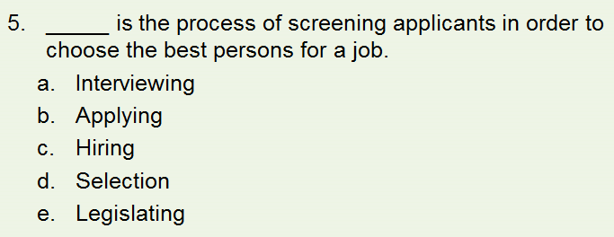
Part 1 – Management Principles and the Records & Information Management Program

Slide 13
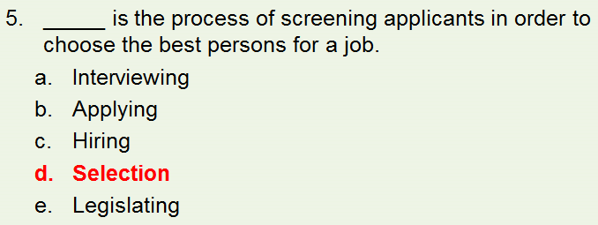
Part 1 – Management Principles and the Records & Information Management Program

Slide 14
Part 2 – Records and Information: Creation and Use
100 multiple-choice questions
Information Framework
  taxonomies, definitions, classifications
Risk Assessments and Audits
Compliance
Information Security and Privacy
Information Creation
  records, metadata, social media, collaborative tools

Slide 15
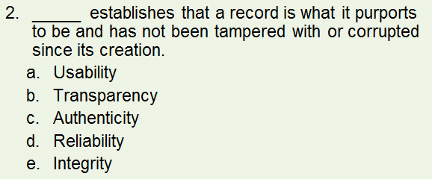
Part 2 – Records and Information: Creation and Use

Slide 16
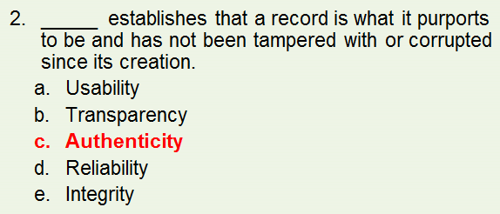
Part 2 – Records and Information: Creation and Use

Slide 17
Part 3 – Records Storage, Retrieval, Conversion, and Facilities
100 multiple-choice questions
Storage
  paper, electronic, and microforms
  structured, semi-structured, and unstructured
Retrieval
  indexing, searching, and legal discovery
Conversion
  paper-to-electronic, film-to-electronic, and electronic-to-electronic
Facilities
  records centers, data centers, and cloud storage

Slide 18
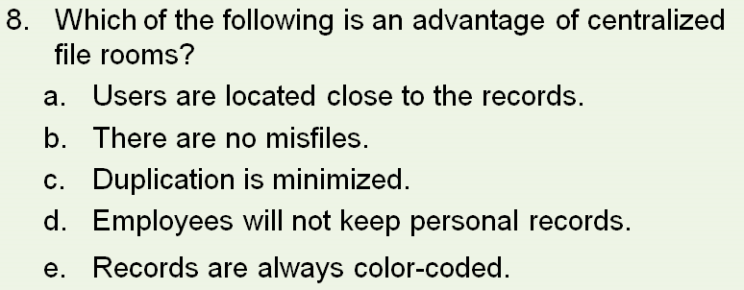
Part 3 – Records Storage, Retrieval, Conversion, and Facilities

Slide 19
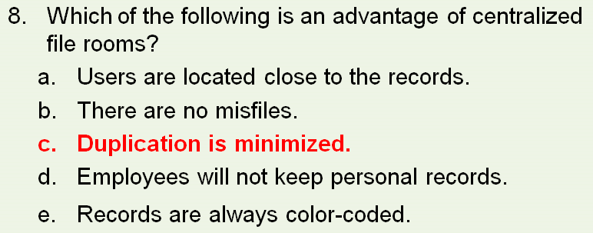
Part 3 – Records Storage, Retrieval, Conversion, and Facilities

Slide 20
Part 4 – Records Appraisal, Retention, Protection, and Disposition
100 multiple-choice questions
Records Inventories
Records Appraisals
Retention Schedule Creation
Retention Schedule Implementation
Retention Schedule Administration
Vital Records Program
Business Continuity
Archives

Slide 21
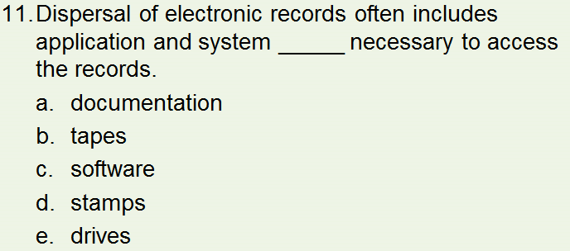
Part 4 – Records Appraisal, Retention, Protection, and Disposition

Slide 22
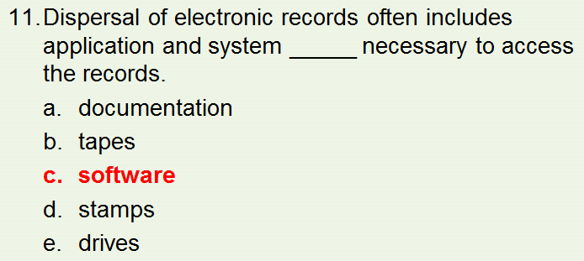
Part 4 – Records Appraisal, Retention, Protection, and Disposition

Slide 23
Part 5 – Technology
100 multiple-choice questions
System Lifecycle
Architecture and Infrastructure
Lifecycle Management
Imaging Technologies
Programs and Applications

Slide 24
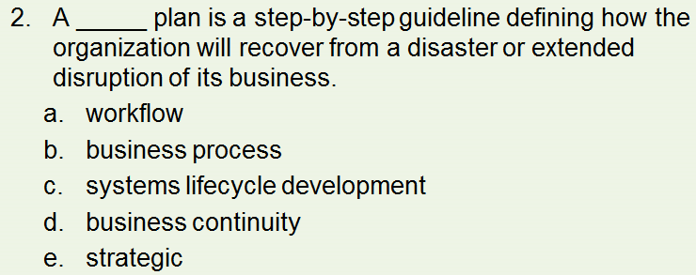
Part 5 – Technology

Slide 25
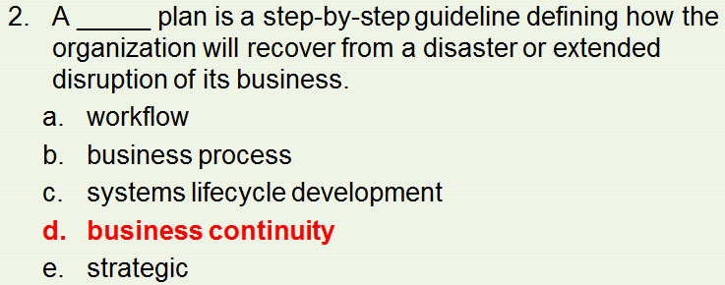
Part 5 – Technology

Slide 26
Part 6 – Case Studies
Two essay questions
60 Point Case Study
  covers a broad scope of records management considerations
40 Point Case Study
  two RIM problem scenarios presented
  Candidates select one of two 40-point case studies

Slide 27
Part 6 – Case Studies
Provide conclusion, summary, or recommendation for case studies actions.
Write with a managerial and professional tone.
Distinguish between facts, conclusions, and recommendations.
Include both records management theory and application.

Slide 28
Part 6 – Case Studies
Review case studies and correct:
  choppy or wordy sentences
  incorrect punctuation
  spelling
  lengthy paragraphs
  inconsistent verb tenses
  lack of transition
  inconsistent formatting
  jargon and acronyms

Slide 29
Part 6 – Case Studies
Graders will look for:
  professionalism
  logic
  completeness
  neatness
  formatting

Slide 30
CRM & CRA Certification Maintenance
Five-year cycle
100 continuing education hours
  conferences: ARMA, AIIM, MER, SAA, NAGARA, NIRMA
  education: seminars, workshops, online coursework
  teach: lecture, present, panel participation
  publish: articles, monographs, whitepapers, books
  attend monthly ARMA meetings
  mentoring and exam grading
Annual dues: $200

Slide 31
Ready, Set…Read
Franks, Patricia C. Records and Information Management, 2nd ed.
Chicago: American Library Association, 2018.
Jones, Gareth and Jennifer George. Contemporary Management, 10th ed.
New York: McGraw-Hill Education, 2017.
Richardson, Blake. Records Management for Dummies.
Hoboken: Wiley, 2012.
Saffady, William. Records and Information Management: Fundamentals of Professional Practice, 3rd ed.
Overland Park: ARMA International, 2015.
Stair, Ralph M. and George Reynolds. Fundamentals of Information Systems, 9th ed.
Course Technology, 2017.

Slide 32
Questions?
Michael DeVanna
michael.devanna@bcbsfl.com
(904) 905-2816

